Slide 1

IMPLEMENTING OPTIMIZATION TECHNIQUES ON NEURAL NETWORK BACKPROPAGATION
BY TEAM NINE
ADITYA KUMAR,ADITYA NAYAK,MEDHASWETA SEN

Slide 2
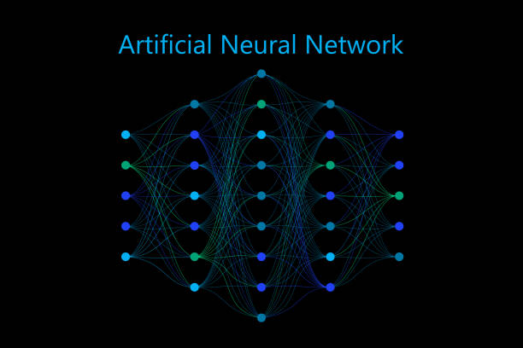
Introduction
Project Scope:
Initial ambition
Final achievement
Notes:
Initial Ambition:
Final comparison –
1. Varying dataset number of features
2. Varying number of layers – parameter numbers
3. Varying transfer functions
4. Varying Learning rate
Compare optimization techniques learned in class – SGD, Variable Learning rate, SGD with momentum, Conjugate gradient, and LM. This should be a generalized code to have the number of layers as input (number of neurons),
Final Achievement:
General neural network with additional capabilities - sgd, conjugate gradient, and lm algorithm implemented using only numpy!!
Performed end-to-end modeling of small datasets using our custom neural network with different optimizers. In-depth analysis is future work.

Slide 3

DATASETS
Three types of datasets considered to be implemented on our neural network:
Small: Housing dataset
Source : Kaggle
Dataset based on data from the 1990 California census.
Includes features such as population, median income, no. of bedrooms etc.
Features can be used to predict the price of each house.
Using this dataset in order to check if small features give optimal results by the neural network.

Slide 4

2. Medium: Spotify - Youtube dataset
Source : Kaggle
Dataset of songs of various artist in the world and for each song is present.
Number of views of the official music video of the song on YouTube.
The dataset consists of features like Valence, Tempo, Duration etc. which can be used to predict the no. of Likes/Views the music receives.

Slide 5

3. Large: Heart Cancer dataset
Source: Kaggle
The following dataset consists of 33 predictor variables such as incident_rate, medincome, povertypercent etc.
These features can be used to predict the deathrate caused by cancer throughout the US.
No further description of the data variables was provided on Kaggle.

Slide 6
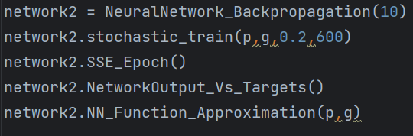
Coding Journey
Homework 6: Where it all began
Notes:
The task was to create a simple 1-S-1 network and train it using stochastic backpropagation training. The architecture took only 1 parameter, the number of neurons.
The task was to approximate a function with multiple inflexion points and see performance with large number of neurons and small neurons.
First i tried for neuron = 2. epoch = 1000, alpha =0.2.
The result

Slide 7
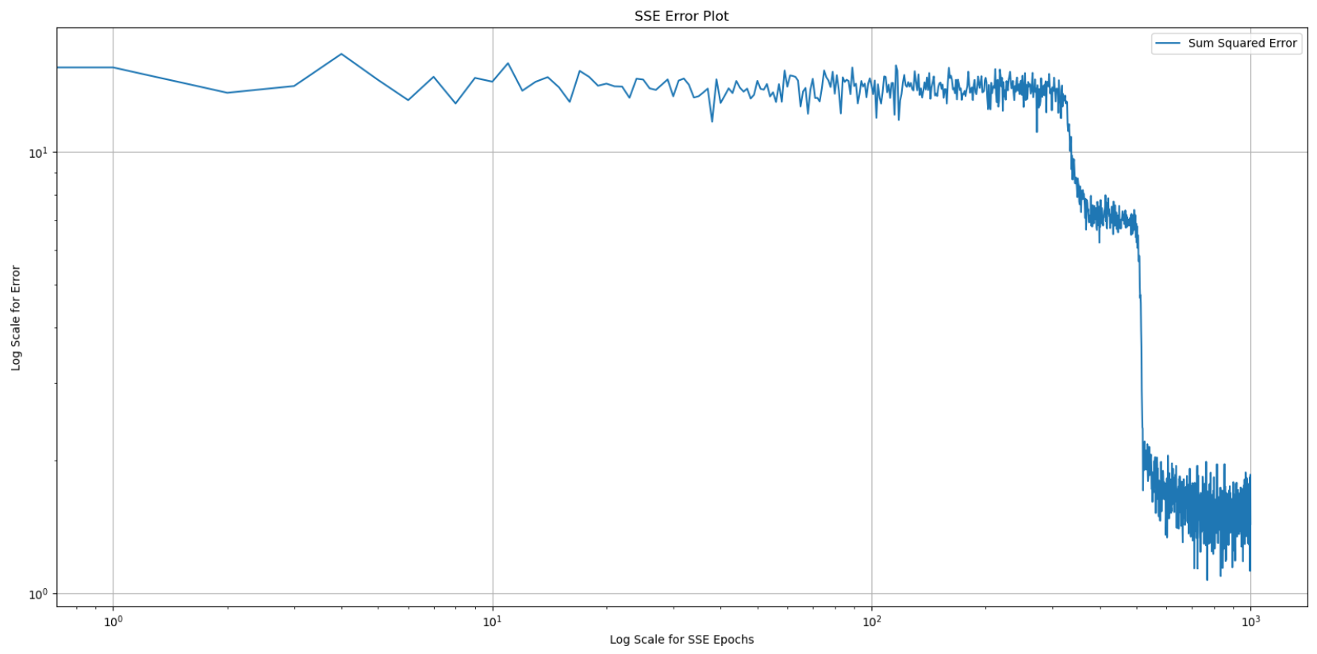
Notes:
SSE

Slide 8
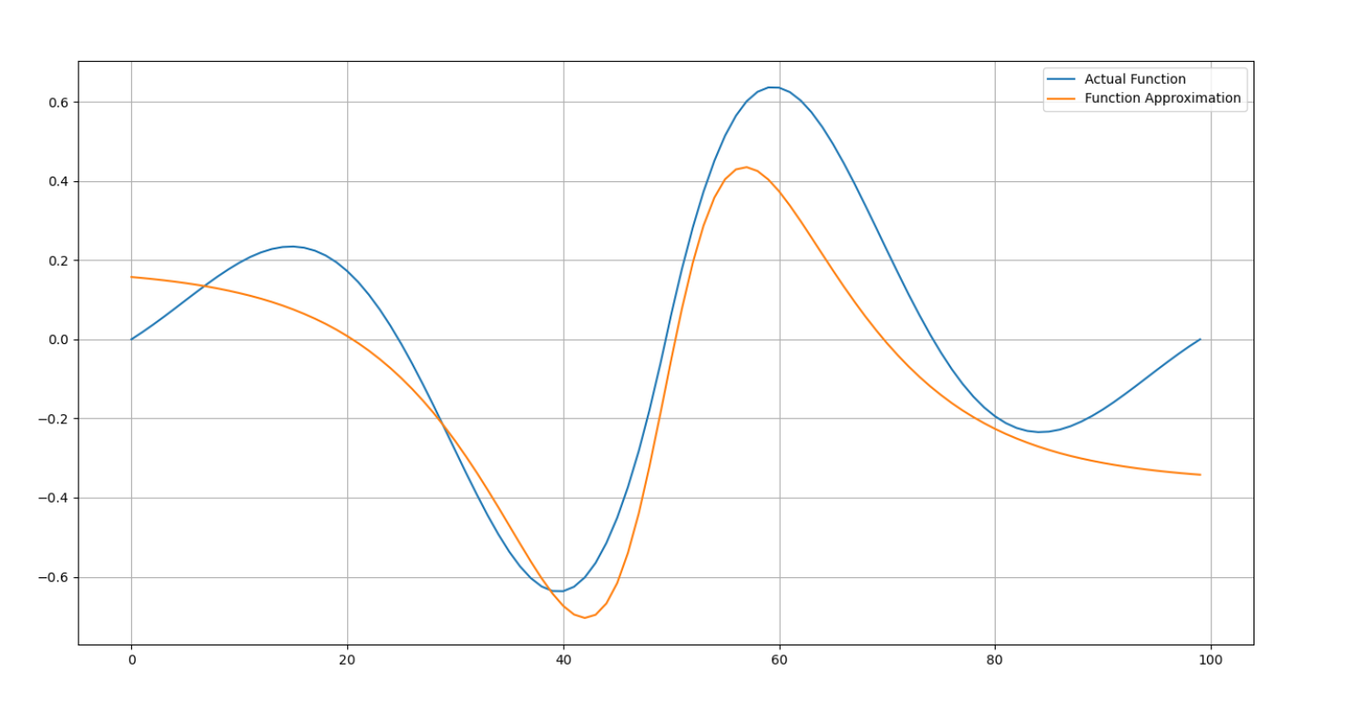
Notes:
Function approximation after complete training

Slide 9
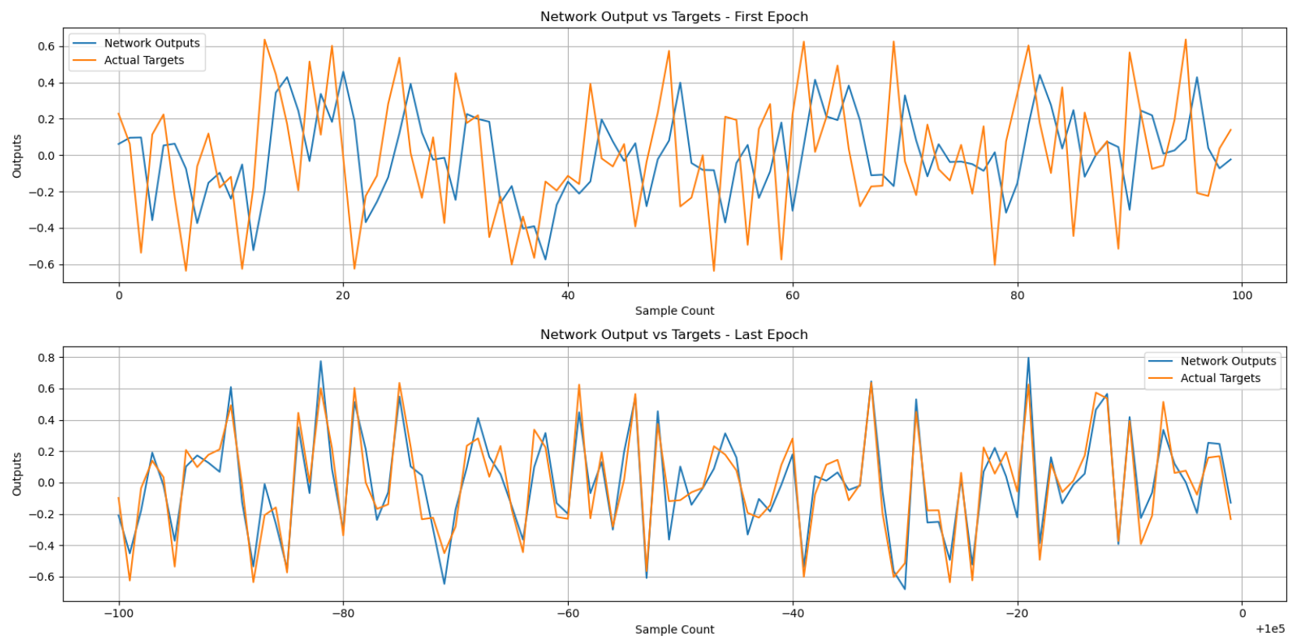
Notes:
First and last epoch comparison

Slide 10
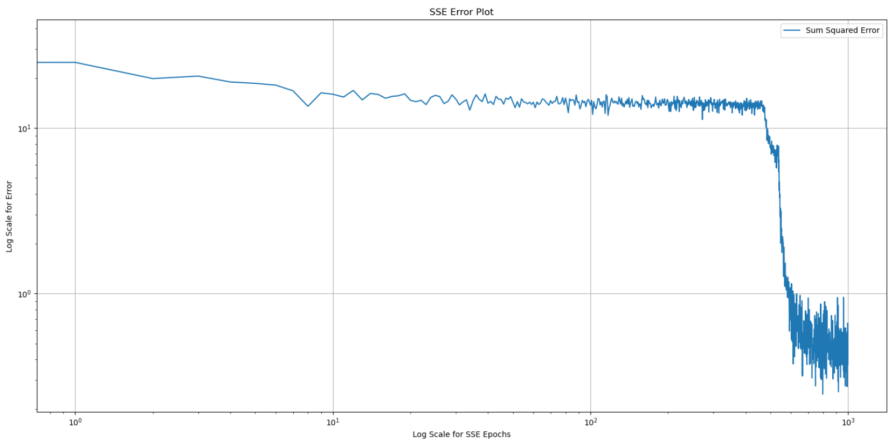
Notes:
Output with 10 neurons, everything else the same
SSE

Slide 11
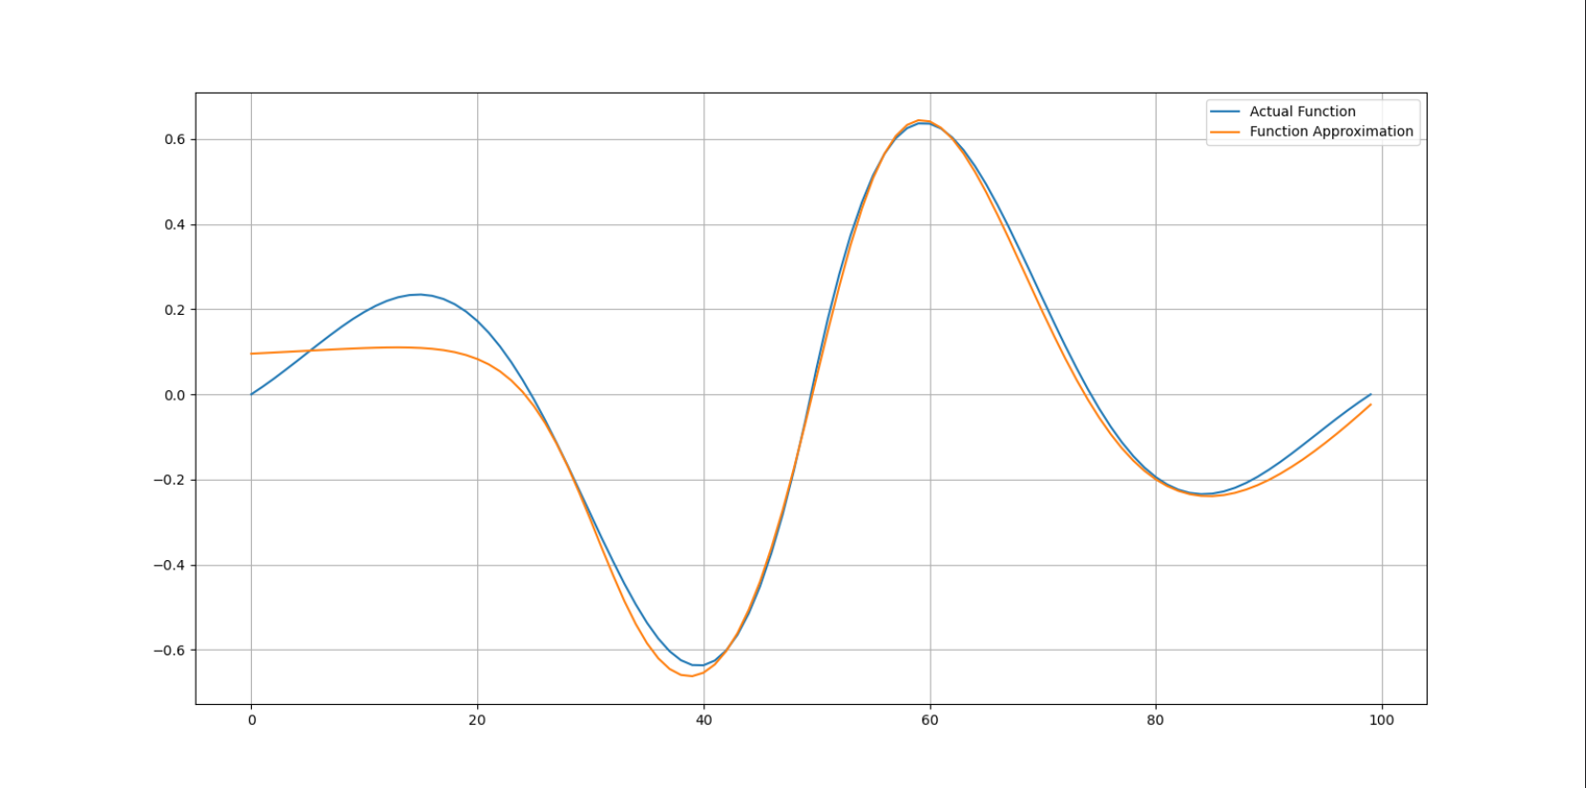
Notes:
Better approximation

Slide 12
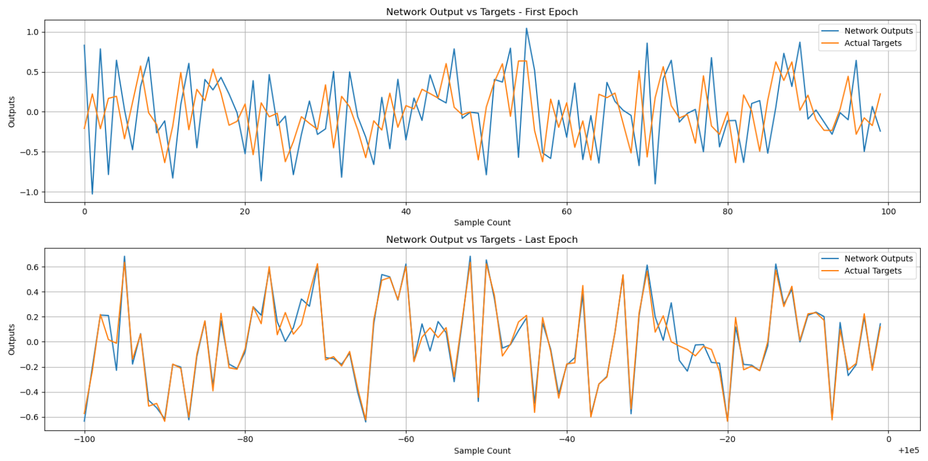
Notes:
First and last epoch comparison - GREAT result

Slide 13
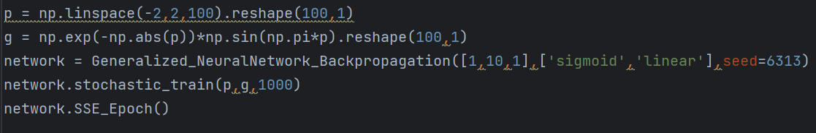
Motivation
Why not general neural network?
Challenges?
Notes:
General neural network creation - custom layers, custom activation function capabilities - (tanh, softmax, sigmoid, relu, square)
Hurdles faced: Error calculation and hence sensitivity propagation was incorrect for the longest time which was causing my weights and biases to explode and activation output to overflow. Helpful note: if weights and biases seem to explode, there is a problem with sensitivity backpropagation. This should be checked first. Additionally, error calculation should be checked.

Slide 14

Stochastic Training
Time for Batch Training
Key Observations:
Notes:
Batch training for 1-s-1 created first. Very simple to replicate the logic to general architecture!!

Slide 15
Batch Training vs Online Training
Maybe Batch training is not all that better than online.
Prior Assumption - faster convergence
Assumption challenged - Different result
Notes:
Prior assumption was that batch training will take lesser number of weight updates to converge to minima
It seemed like batch training takes up longer time to converge, with same number of epochs.
This is possibly because of the lesser number of weight updates within each epoch. Indicating that incremental training is faster. Epoch = 1000, 0.2 alpha batch size = 100. only 1000 weight updates whereas incremental learning has 100,000

Slide 16
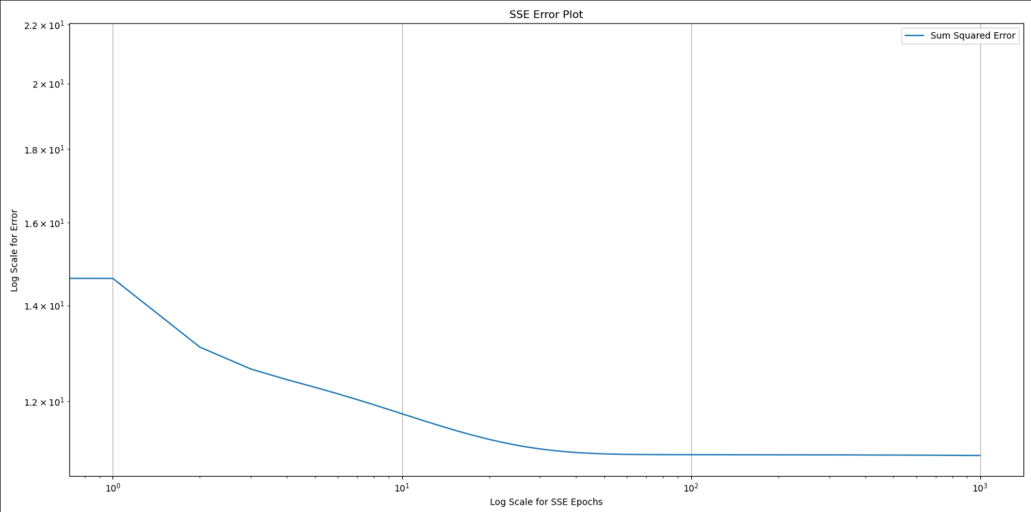

Slide 17
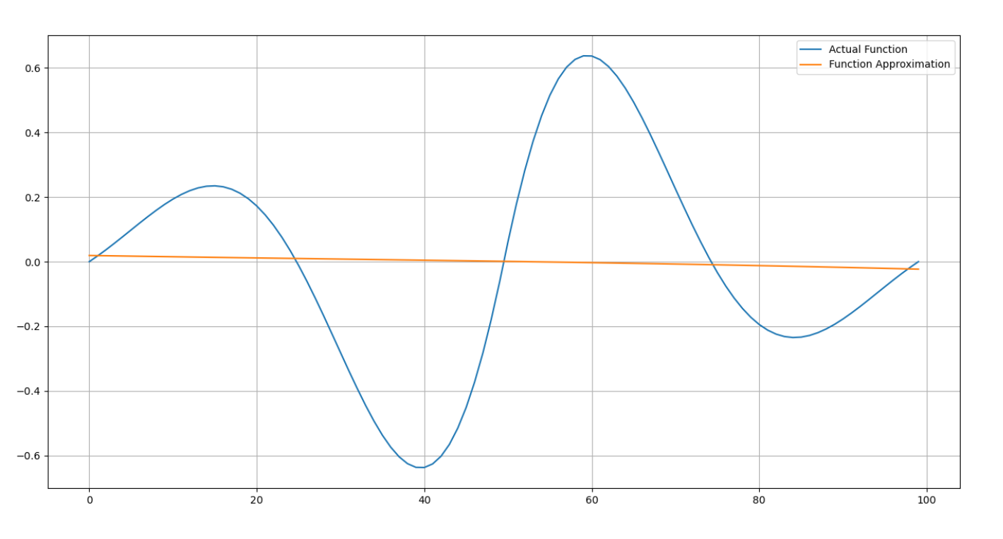

Slide 18
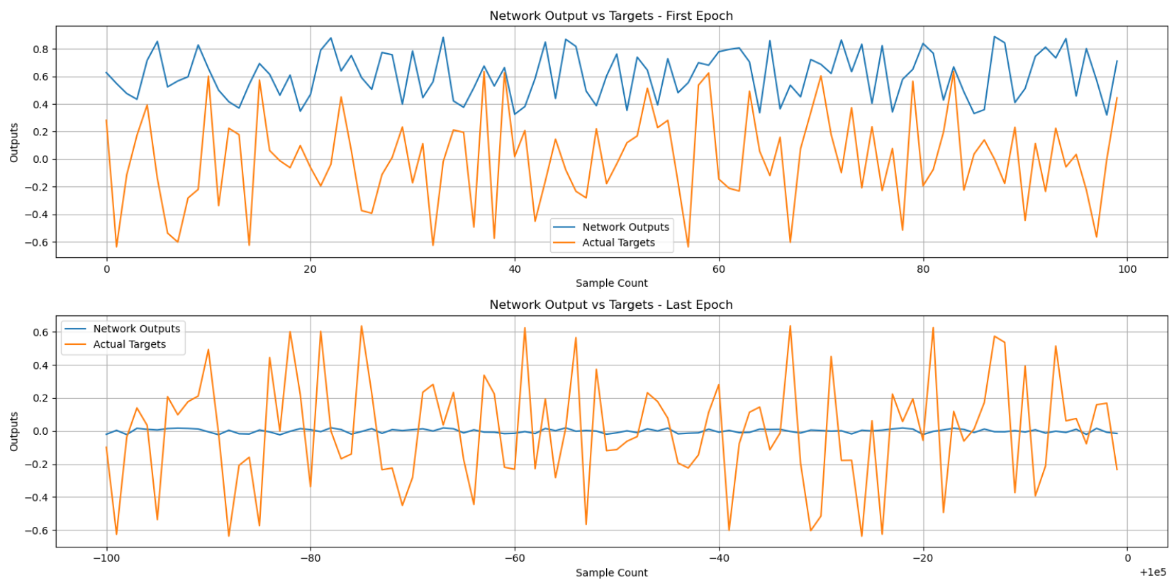

Slide 19
Hypothesis testing
Comparison between same number of weight updates for batch vs online.
Notes:
Online training converges in lesser number of total weight updates as compared to batch training (tested with a small batch size of 5, total number of weight updates for network to approximate function was lesser than batch updates.)

Slide 20
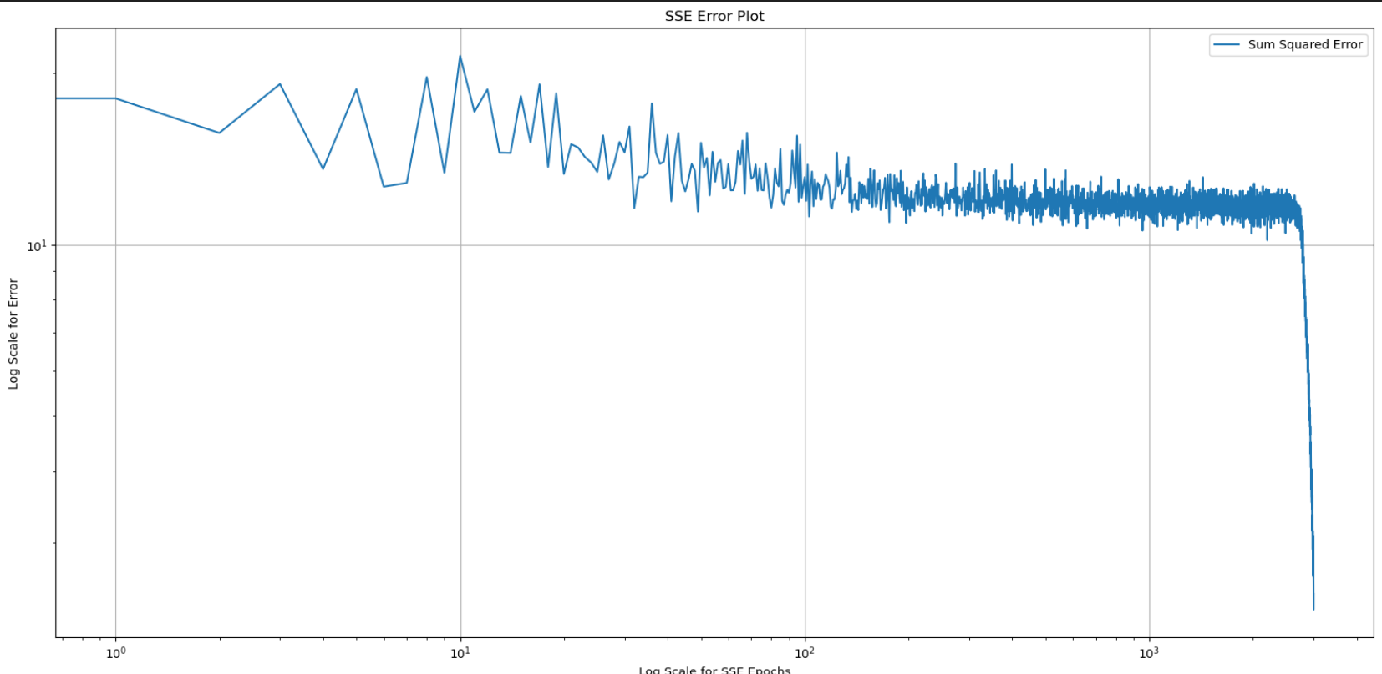
Notes:
Batch SSE result 60,000 weight updates - 3000 epochs, batch size of 20

Slide 21
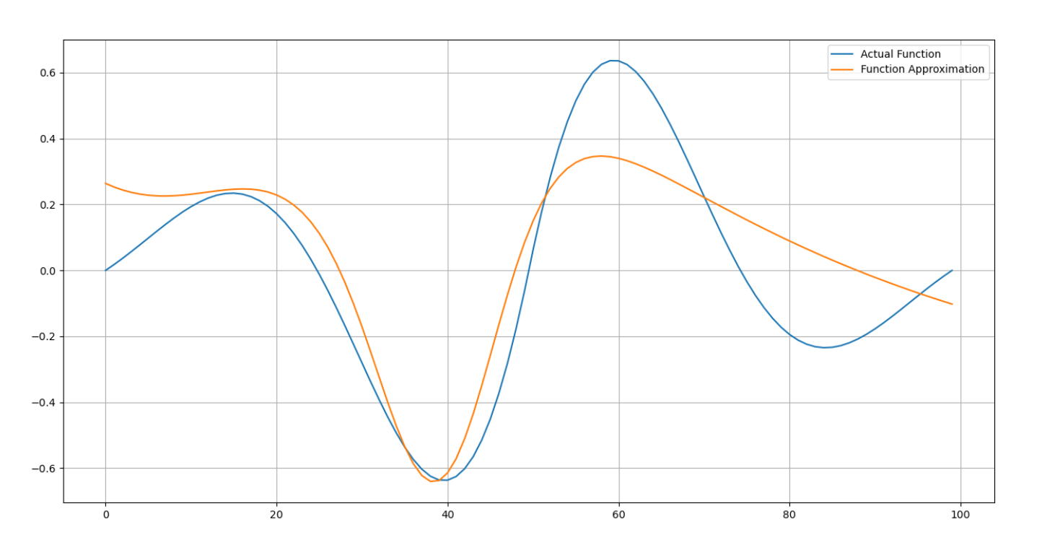
Notes:
Function approximation

Slide 22
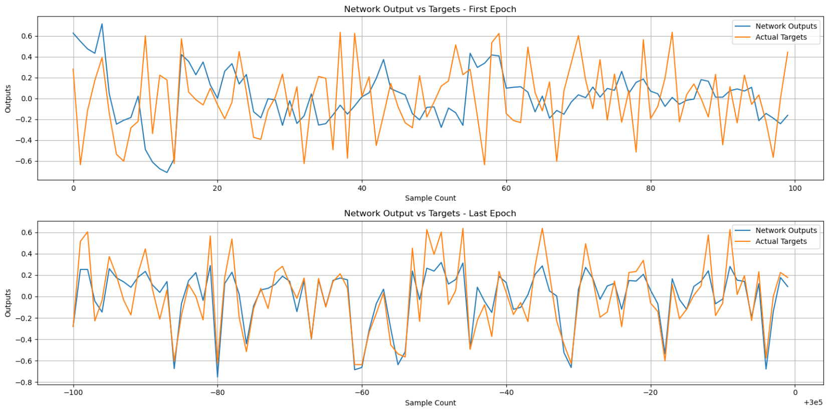
Notes:
Function approximation

Slide 23
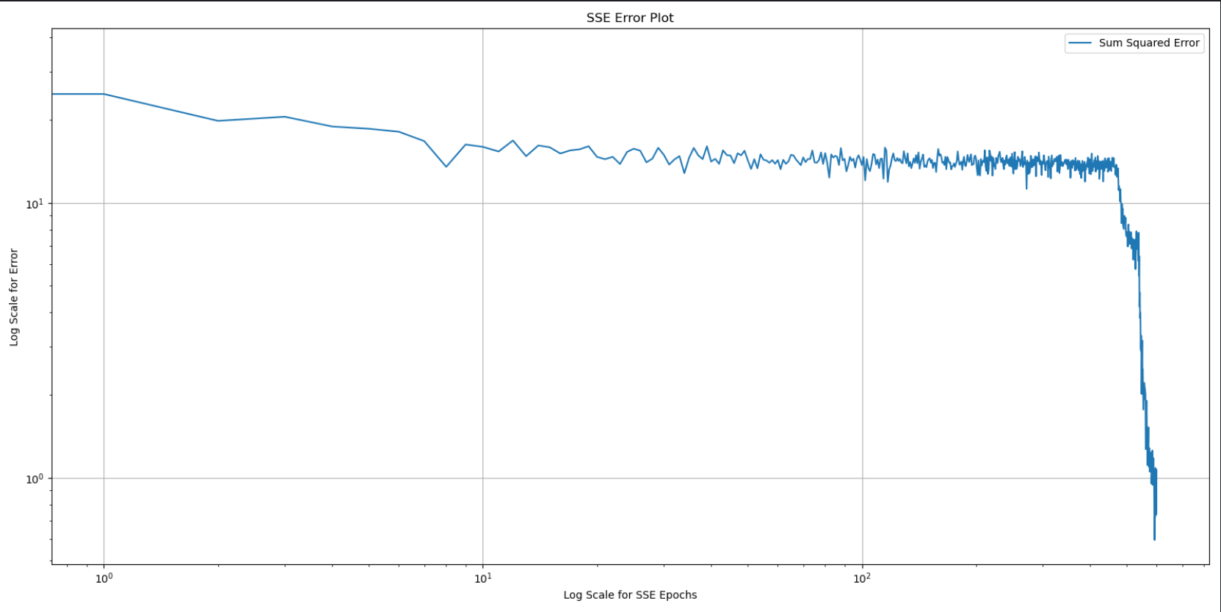
Notes:
Online SSE

Slide 24
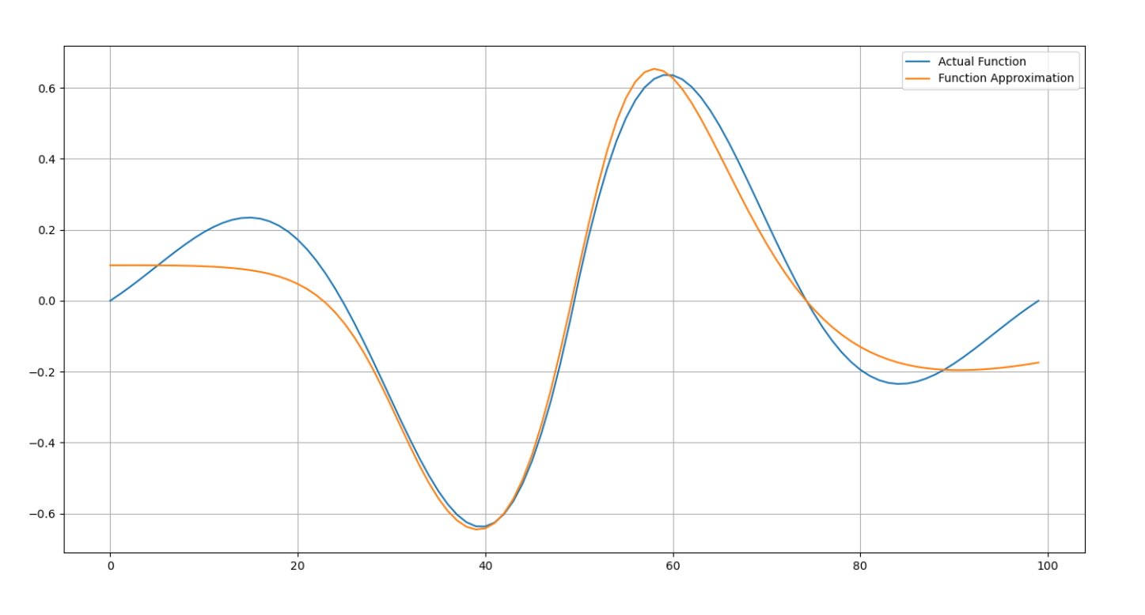
Notes:
Function Approx

Slide 25
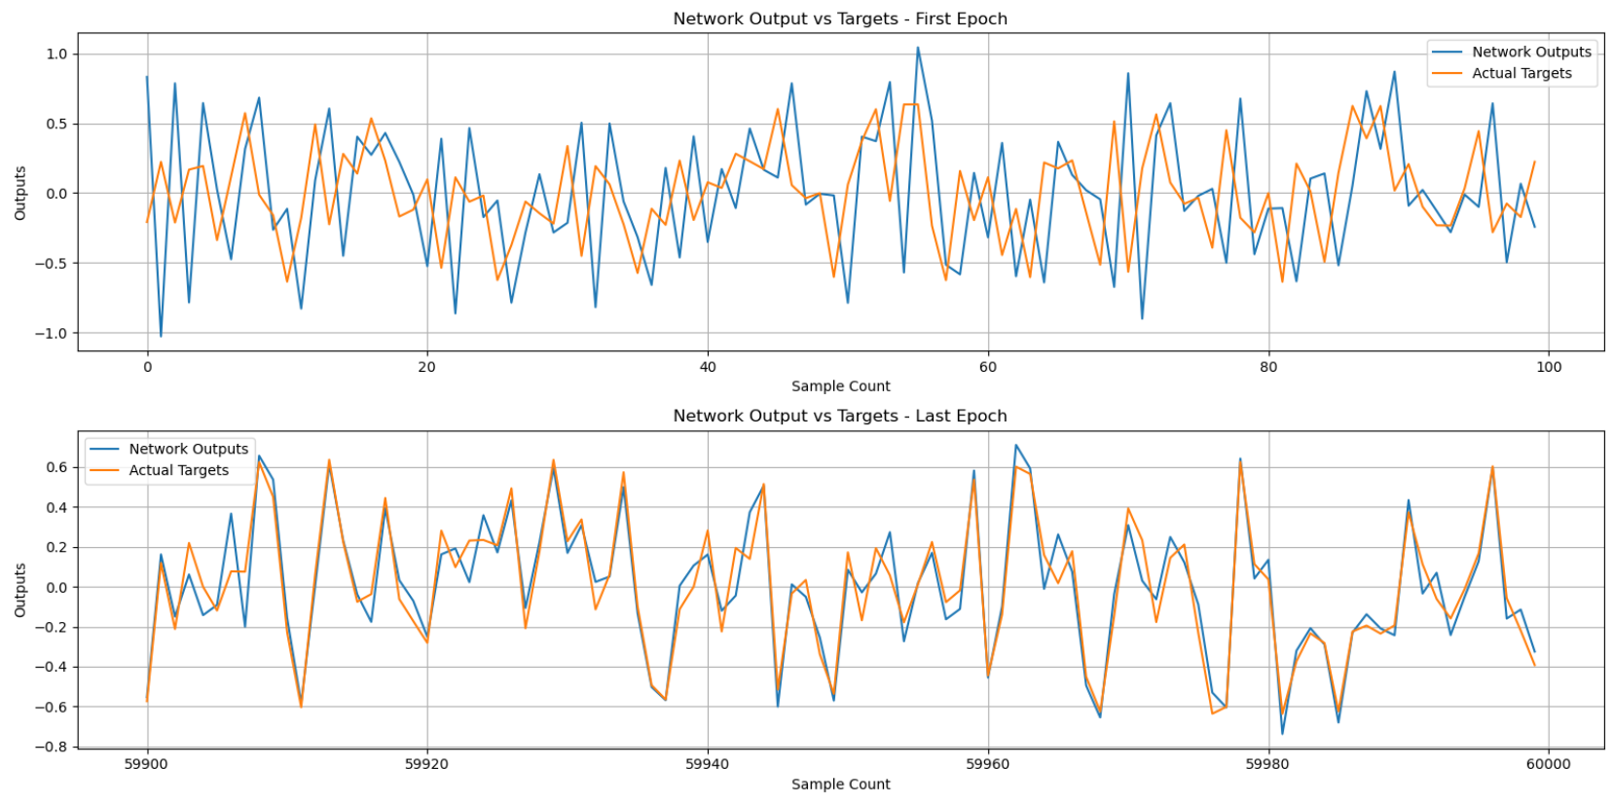
Notes:
Function Approx

Slide 26
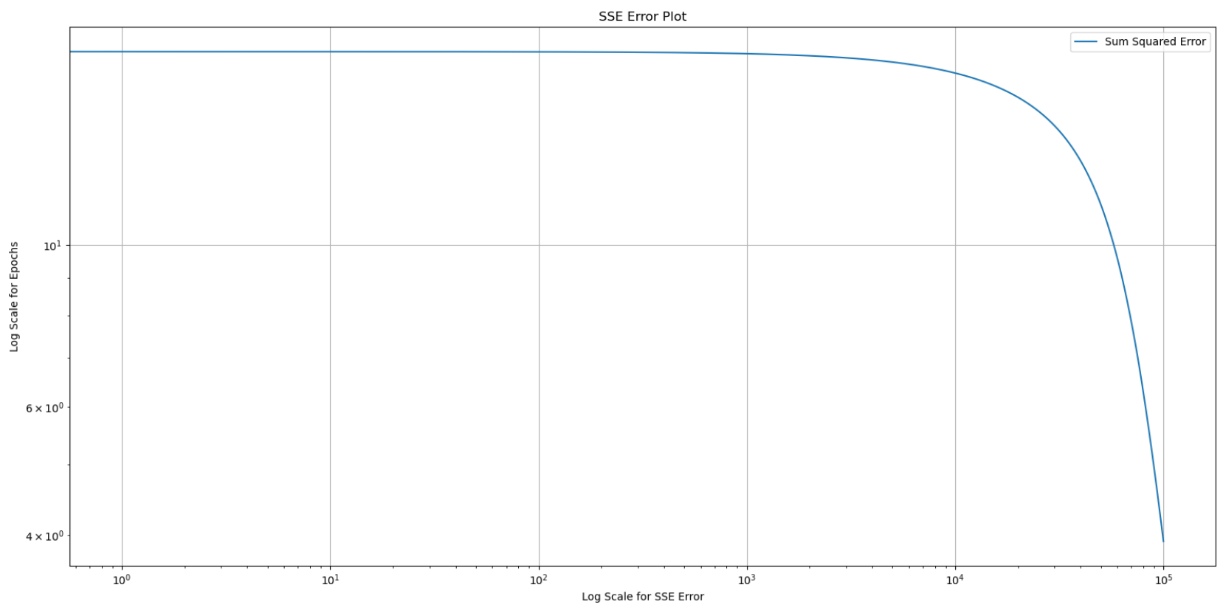
However!
Notes:
Like Prof. Jafari mentioned, With full batch train, the error plot will always be a smooth curve.
However, this graph is obtained for another purpose. It is obtained for 100,000 epochs for full batch, the same number of weight updates as online training with 1000 epochs. The SSE is in the range 3.5 for full batch, whereas online it drops to 0.01.
Incremental learning seems to be with the winner here!

Slide 27
Next up - LM Algo
Challenge 1 - The Jakobian.
NN_design to the rescue - Problem 12.5
Added Capability of manual input
Challenge 2 - Weight update
Notes:
Marquadt sensitivity is propagated the same way as regular stochastic gradient descent. However the real difficulty was implementing the Jakobian. The NN design textbook was very hard to decipher and translate to code. However was able to do it with continuous effort and hours at a stretch.
Got the dimensions to match - Next step was to confirm using NN design book. To do this i had to intialize the weights based on user input which led me to add yet another capability into the neural network model.
Challenge 2:
Parameter updates are also difficult as change in parameter updates (delta_x) are stored in a single array. Will have to update extract updates of each parameter and update accordingly.

Slide 28
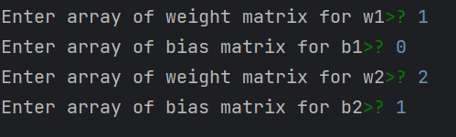
The Code:
Weight matrix from the book
Notes:
Marquadt sensitivity is propagated the same way as regular stochastic gradient descent. However the real difficulty was implementing the Jakobian. The NN design textbook was very hard to decipher and translate to code. However was able to do it with continuous effort and hours at a stretch.
Got the dimensions to match - Next step was to confirm using NN design book. To do this i had to intialize the weights based on user input which led me to add yet another capability into the neural network model.

Slide 29
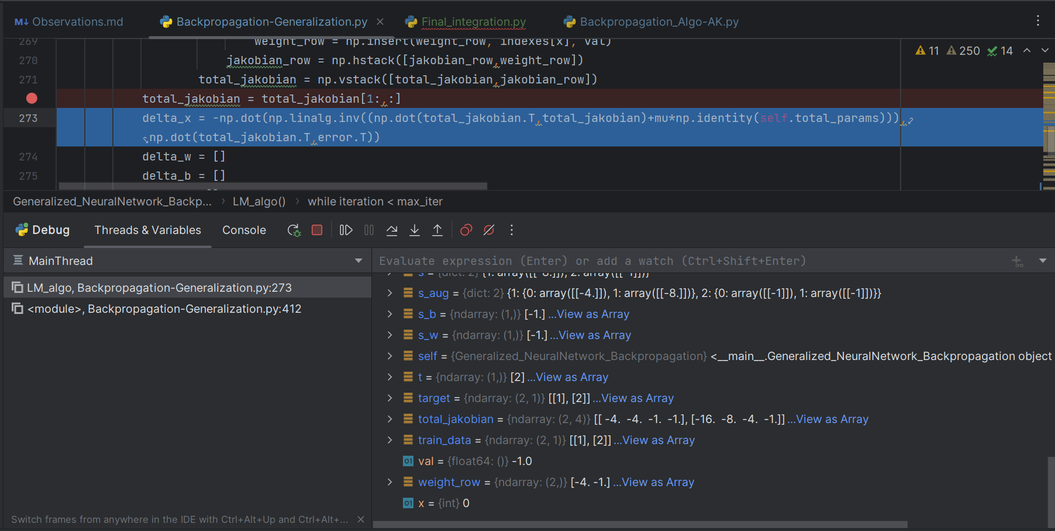
Notes:
How jakobian was matched

Slide 30
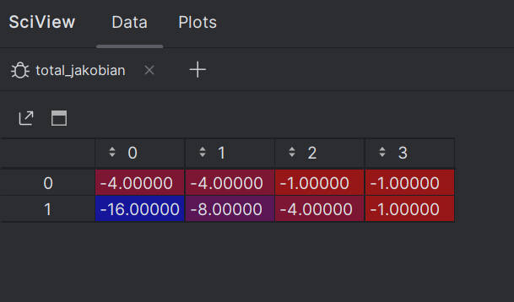
Notes:
Final jakobian matrix matching the textbook

Slide 31
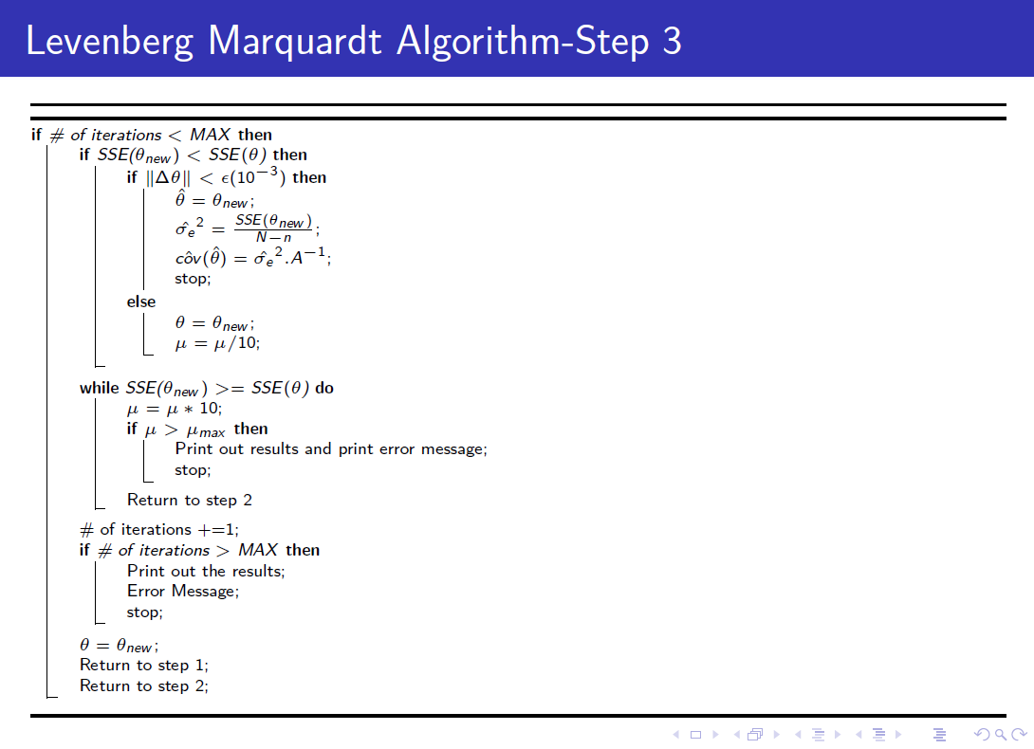
Reference for pseudo code

Slide 32
Another Challenge: Theoretical concept confirmed
LM - Successful!
Testing fail on synthetic function.
Notes:
After successfully completing the lm algorithm, what was left was to test the same function approximation problem.

Slide 33
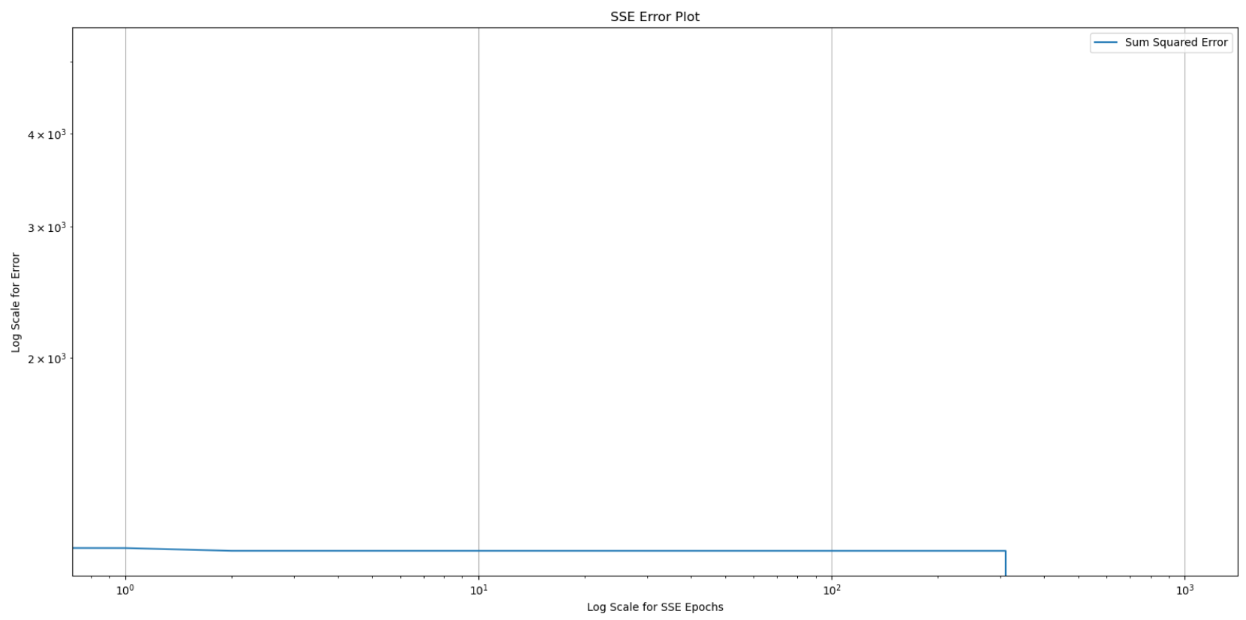
Notes:
SSE Plot.
I had given provisions in my code according to pseudo code to check for instabilities.
After having a look at the SSE vector. it seemed like SSE was not decreasing further beyond a point - 10.something
The weight were not changing.

Slide 34
Issue resolution
Parameter tweakings: mu_max, convergence criteria, max number of iterations…
No luck
Forgot about local minima/saddle point!
Notes:
Algorithm was able to converge in mere 12 epochs after different weight and bias intitialization was chosen!!
* I was using the same seed repeatedly and therefore, the weights and biases were initializing to the same values and getting stuck in the same local minima/saddle point.

Slide 35
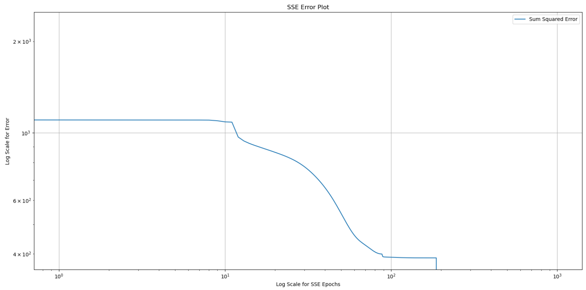
Issue resolution
Notes:
SSE plot with different initialization. SSE came down to 3-4 from 11.

Slide 36
Learning
After observing the LM algo issue, it has become clear how it is important to initialize the network with different weights and biases to get optimum results and avoid saddle point/local minima issues.

Slide 37
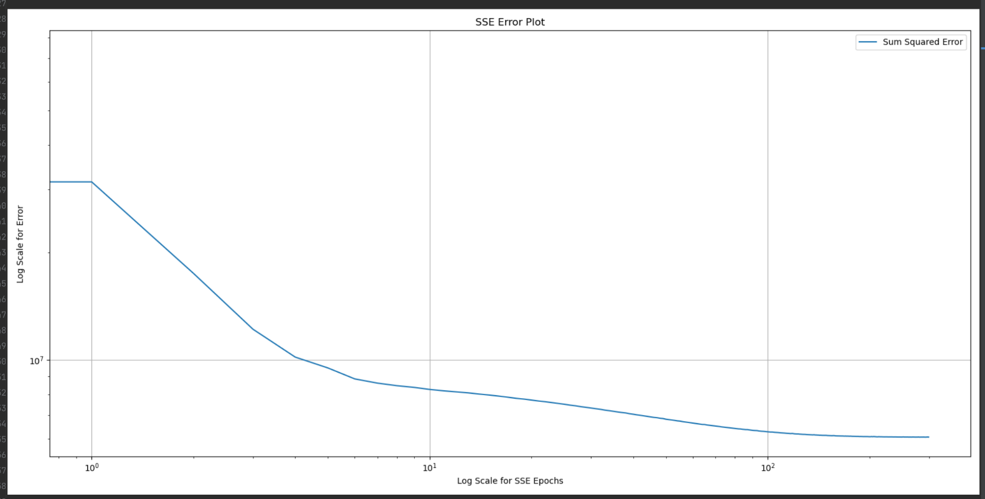
CONJUGATE GRADIENT
Notes:
Conjugate Gradient (CG) is an optimization algorithm commonly used in the context of backpropagation in neural networks to efficiently solve for the optimal weights that minimize the cost function.
Backpropagation is a widely used method for training neural networks. During backpropagation, the error between the actual and predicted output is calculated, and the weights of the neural network are adjusted to minimize this error. The optimization problem of finding the optimal weights can be formulated as a quadratic minimization problem, where the cost function is a quadratic function of the weights.
The CG algorithm is particularly useful for solving this quadratic minimization problem efficiently. The algorithm utilizes information from the previous iterations to converge to the optimal solution in fewer iterations compared to other optimization algorithms like gradient descent.
The CG algorithm maintains a conjugate set of search directions, where each new search direction is conjugate to all previous search directions. This property allows the algorithm to make use of previously calculated gradients to compute the next search direction, leading to faster convergence.
During backpropagation, the CG algorithm is used to compute the gradient of the cost function with respect to the weights of the neural network. This gradient is then used to update the weights of the neural network. The CG algorithm is also used to determine the step size along the search direction, ensuring that the optimization problem is solved efficiently.
Overall, the CG algorithm is a powerful optimization method for solving the quadratic minimization problem that arises during backpropagation in neural networks. It can help reduce the computational cost of training neural networks while also improving the accuracy of the trained model.
THIS IS THE SSE FOR THE SAME FUNCTION APPROXIMATION USING CONJUGATE GRADIENT FOR 300 EPOchs

Slide 38
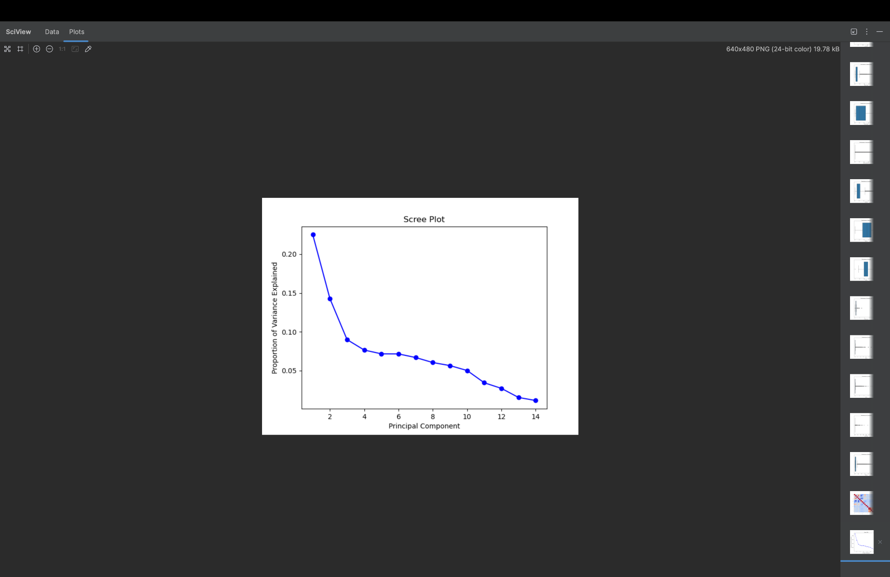
Notes:
SO UNFORTUNATELY, THE CUSTOM LM AND SGD SEEMED TO HAVE A SHAPE MISMATCH SOMEWHERE WITH TRAINING INPUT, SINCE THE CODES WERE TOO LONG TO FIX, WE WERE’NT ABLE TO PUT THEM IN OUR RESULTS.

Slide 39
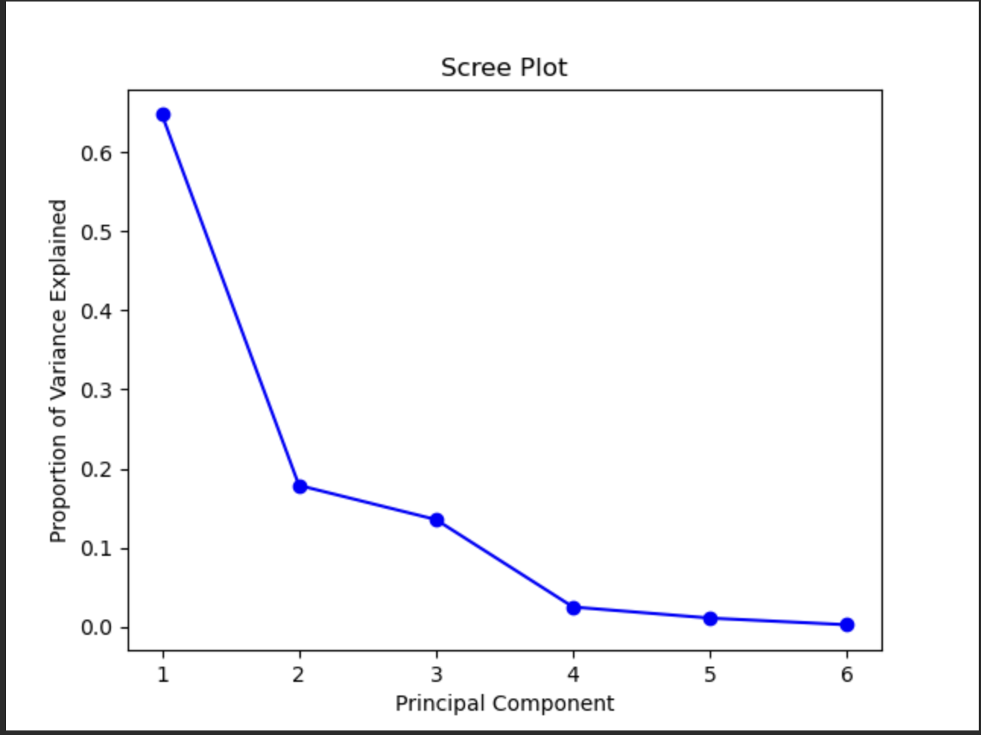

Slide 40
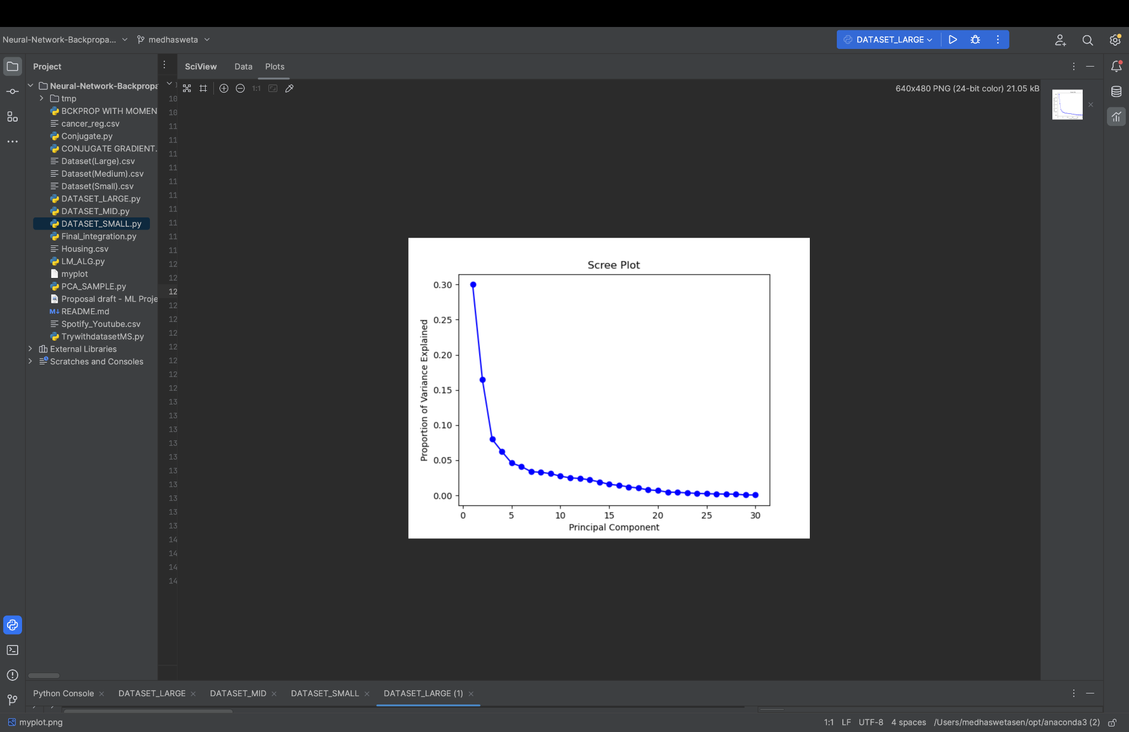

Slide 41
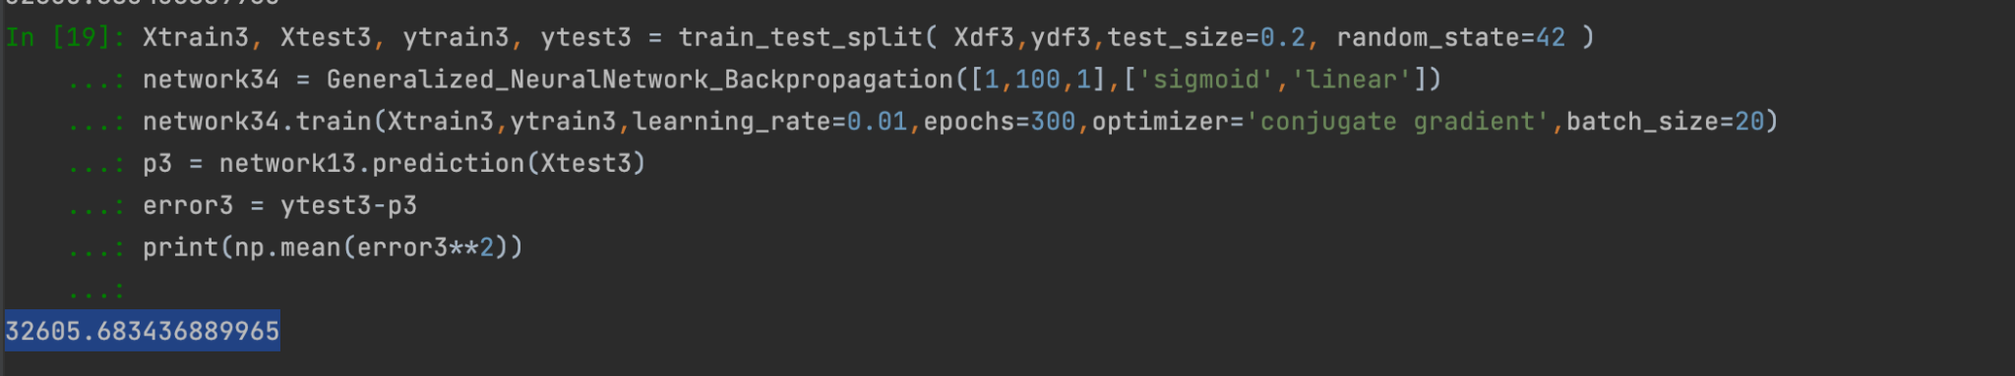
CONJUGATE GRADIENT
Notes:
THIS IS THE SSE FOR THE SAME FUNCTION APPROXIMATION USING CONJUGATE GRADIENT FOR 300 EPO

Slide 42
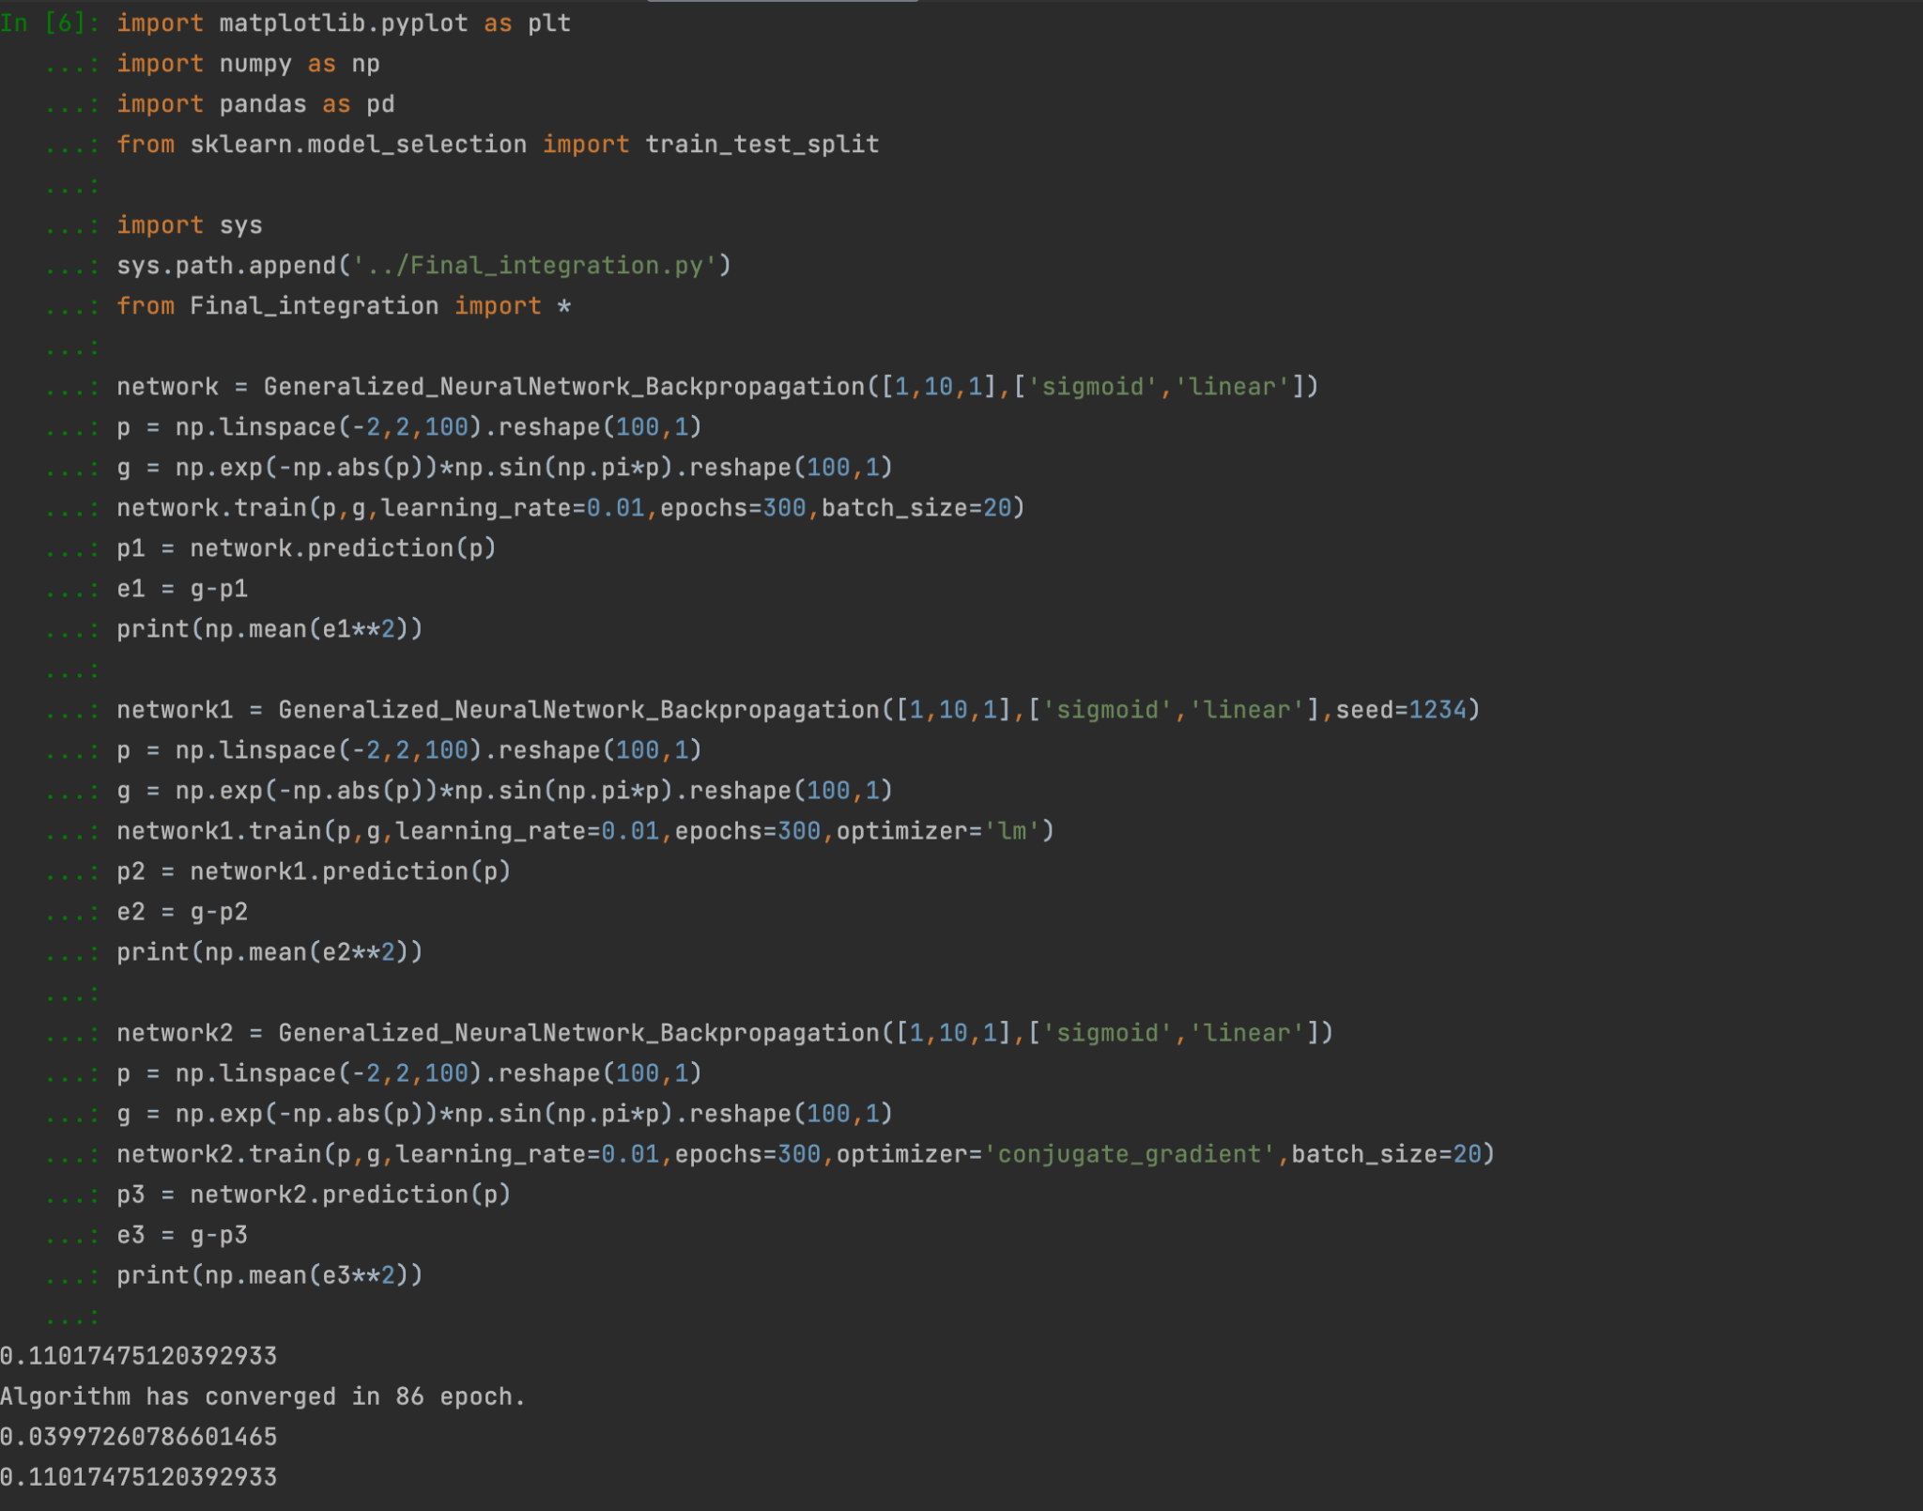
RESULTS

Slide 43
Future Work
Add Verbose type feature in custom training codes so that the status of training can be viewed easily.
Create an interactive dash enable dashboard that will display the findings of this project effectively.
Due to observed issue with LM Algo, another added feature in code could be, multiple seed initializations and picking the lowest SSE score/scores model.
Time complexity comparison in backend execution.
Another added argument that takes in the metric argument - Typically SSE for classification and MSE for regression.
Perform in-depth comparison using previously defined criterias.
Comparison with conventional models.

Slide 44
REFERENCES
“Neural Network Design” (2nd Ed), by Martin T Hagan, ISBN 0971732116
Henry P. Gavin (2022), “The Levenberg-Marquardt algorithm for nonlinear least squares curve-fitting problems”, Duke University, Department of Civil & Environmental Engineering.
Rauf Bhat (2020), “Gradient Descent with Momentum”, Towards Data Science.
I. Khan et al (2020), "Design of Neural Network with Levenberg-Marquardt and Bayesian Regularization Backpropagation for Solving Pantograph Delay Differential Equations" in IEEE Access, vol. 8, pp. 137918-137933, doi: 10.1109/ACCESS.2020.3011820.

